Slide 1
High Availability, Backups, and Disaster Recovery
Module 12

Slide 2
Agenda
Protection
AV & ISA
Recoverability
Versions, Recycle Bin, MSIT Tool
High Availability Options
NLB, SQL Options
Backups & Restores
STSADM, Central Admin, 3rd party

Slide 3
Protection
Antivirus for SharePoint
All the normal reasons
How does it work
SharePoint has APIs to attach to
Control if scan up or down or both
Plan for some extra CPU overhead

Slide 4
Protection
Application Firewall in front of SharePoint
Most popular?
ISA Server 2006
ISA does more than just lock down port
Packet inspection
Verb checking
Link translation
Advanced routing based on rules
And more
This one time with ISA I…

Slide 5
Protection
Thinking about both AV and ISA
Look at Microsoft ForeFront
Suite of tools that combines both
Also allows for keyword scanning for compliance
Fully integrated

Slide 6
Recoverability
Easy built in pieces
Versions
Two stage recycle bin
Add a free piece
Microsoft IT Undelete tool

Slide 7
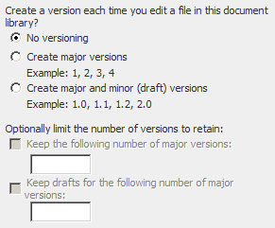
Versions
Usually need to be turned on
Defined at the Library level
Watch the added storage
Full version kept, not the delta
Consider limiting number

Slide 8
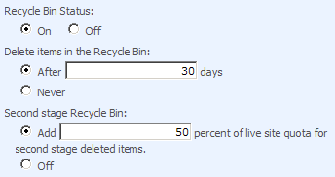
Two stage Recycle bin
Good for Mother Earth and SharePoint
Protects items and lists
Not Sites!
Stage one
User recycle bin
View All Site Content
Easy to recover
Stage two
Site Collection Administrator access only
Does not count against quota

Slide 9
MS IT Site Backup Tool
Free add on
www.codeplex.com/governance
Backups sites or site collections before they are deleted
If backup fails does not allow site to be deleted
Notifies owner of site via email of delete
A must have add on!

Slide 10
All of those nines
Acceptable uptime percentage | Downtime per day | Downtime per month | Downtime per year
95 | 72.00 minutes | 36 hours | 18.26 days
99 | 14.40 minutes | 7 hours | 3.65 days
99.9 | 86.40 seconds | 43 minutes | 8.77 hours
99.99 | 8.64 seconds | 4 minutes | 52.60 minutes
99.999 | 0.86 seconds | 26 seconds | 5.26 minutes

Slide 11
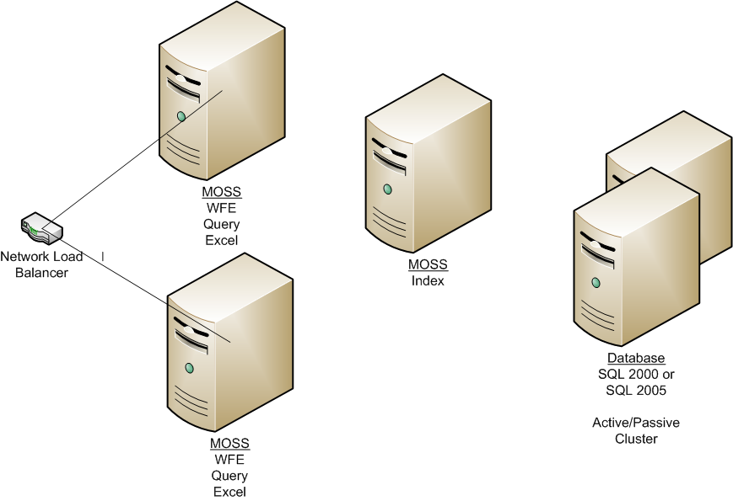
High Availability
Build a high avail farm
Technologies involved
Network Load Balancing
SQL failover

Slide 12
Network load balancing
NLB
Software or hardware supported
W2k3 NLB performs well
Hardware solutions are better (but not free)
Couple of things to remember
Sessions must be persistent/sticky/single affinity
Kerberos has challenges with NLB
Windows NLB not intelligent

Slide 13
SQL Options
SQL Snapshots
SQL Mirroring
SQL Log Shipping
SQL Clusters
Pick your poison

Slide 14
SQL Snapshots
Takes a moment in time “snapshot” of your data
Read only replica of the data
Attach from separate SharePoint Farm
Recover pieces of data
KB929649 for details

Slide 15
SQL Mirroring
Multiple configuration options
Requires 2 or 3 SQL Servers
If primary fails SQL can automatically failover
SharePoint needs help with the move
Have to point DB connections to new SQL Server
Considered warm backup
Look to MSFT whitepaper for guidance
http://go.microsoft.com/fwlink/?LinkId=83725&clcid=0x409

Slide 16
Mirror recovery options
High Performance (Enterprise)
High Availability (Enterprise)
High Protection (Standard or Enterprise)

Slide 17
SQL Log Shipping
Like mirroring except server is cold
Target server is read only
Allows multiple target databases
Performs well over WAN
Not well documented for SharePoint

Slide 18
SQL Cluster
Hot backup
Typical Active/Passive cluster
Two SQL Servers (physical)
Shared storage (SAN) for Databases
Active server goes down Passive picks up
Since storage is shared databases are already there
Negatives
Complex
Expensive
Servers same data center
Storage is single point of failure

Slide 19
Backup GUI
Central Admin > Operation > Backup & Restore
Backups to UNC path
Allows whole farm or granular
Web apps
Content DBs
SSP DBs
Search DBs
Search Index

Slide 20
Backup details
Backups Config DB
Restoring not supported
GUI has no schedule
Does not backup
Files on file system
IIS settings
Whitepaper help
http://technet2.microsoft.com/Office/en-us/library/288fecfb-53fb-4988-89d7-b7888f82bf961033.mspx?mfr=true

Slide 21
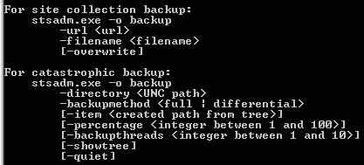
Backup Stsadm
Stsadm.exe –o backup
Backup site collection
Backup whole farm
-directory
Can script to setup automatic backups
Don’t forget cleanup
Performance intensive
Avoid running during usage hours

Slide 22
Other things to backup
The 12 hive
Inetpub folder
C:\windows\assembly – GAC
Alternate Access Mappings
Anything you have ever installed on the server
Custom features and Web Parts
All of your settings
Write the down. Sadly you can’t restore the config DB so it would be nice to have a reference of the accounts and settings you have used.

Slide 23
SQL Backups
Use existing procedures
Allows for content recovery
Will take extra work to restore
Can not backup the index
Don’t bother backing up
Admin database
Config database
Search property database

Slide 24
Other backup gotchas
Make sure you are at the same patch level
Doesn’t write to tape so pick the files up in your nightly job
Permissions needed
SQL Service account
App pool account
Timer service account
All need write to backup location
Can’t backup/restore on same farm unless overwrite
No copies (Site GUIDS conflict)

Slide 25
3rd Party Options
Microsoft Data Protection Manager
Commvault
AvePoint DocAve

Slide 26
Restore from backup
Using Central Admin/Stsadm –directory
Rebuild server
Patch to same level
Configure central admin
Create same Web applications (no site collection)
Restore backup
Reconfigure IIS
Reconfigure AAM
Redeploy addon’s (Features, etc)

